Slide 1


Aziz Imanov
27.11.2021

Slide 2

Outline
Executive Summary
Introduction
Methodology
Results
Conclusion
Appendix

Slide 3
Executive Summary
Methodologies applied in this project:
1) Data Collection (API, Web-scraping, CSV file available online);
2) Data Preprocessing / Wrangling;
3) Exploratory Data Analysis (EDA) and analytical visualization;
4) Building predictive Machine Learning models and evaluation.
Summary of all results:
After rigorous analysis of historical data it becomes certain that some mutually unrelated parameters of a rocket launch can predetermine the mission’s landing outcome.

Slide 4
Introduction
The background of the project:
As you may or may not be aware, as any other industry space industry is also becoming more and more commercialized by private companies like: SpaceX, Rocket Lab, Blue Origin, Boeing, etc. The increasing number of private space companies builds up a competition for services and products that can be provided for the industry. This competition among the companies amplifies their will to come up with better or new services and products in terms of factors like: quality, efficiency and cost. For a company that wants to participate and lead the market of space industry it is crucial to find the ‘Golden Ratio’ between these factors. To achieve this goal a company needs to use modern tools and technologies. One of the main tools on this endeavor and one which I am going to use extensively to get insights from a competitive company is Data Science.
Key question to answer:
The goal of this project is – based on historical data to determine to a certain level of accuracy whether the landing of the SpaceX rocket’s first stage is going to be successful or not during the upcoming launch. The outcome of this research will potentially enable us to set a competitive price for the rocket launch provided by our company.

Slide 5


Slide 6
Methodology
Executive Summary
Data collection methodology:
SpaceX REST API;
Web-scraping from SpaceX’s Wikipedia page dedicated to Falcon 9 and Falcon Heavy launches;
A CSV file available online.
Perform data wrangling:
Data wrangling / preprocessing is done using Python’s Pandas library.
Perform exploratory data analysis (EDA) using visualization and SQL
Perform interactive visual analytics using Folium and Plotly Dash
Perform predictive analysis using classification models:
Logistic Regression, Support Vector Machine, Decision Tree, K-Nearest Neighbors are the machine learning models used for classification and prediction.

Slide 7
Data Collection
The data for this project was collected using an API, Web-scraping technique and a downloaded CSV file available online.
SpaceX’s REST API
Web-scraping Wikipedia
CSV file
JSON file
Pandas Dataframe

Slide 8
Data Collection – SpaceX API
SpaceX’s REST API
This flowchart represents requests from SpaceX’s various APIs to access the appropriate data for further preprocessing.
Link to the file on GitHub:
https://bit.ly/31229Vg
Request Launch data from Launch API
Request Booster data from Rockets API
Request Site data from Launchpads API
Request Payload data from Payloads API
Request Core data from Cores API
DataFrame

Slide 9
Data Collection - Scraping
Wikipedia page
This flowchart represents the process of Web-scraping from SpaceX’s Wikipedia page dedicated to the Falcon 9 and Falcon Heavy launches.
Link to the file on GitHub:
https://bit.ly/3lbCSix
Request Launch data from the Wikipedia page
BeautifulSoup object
Adding data to the predefined lists
DataFrame

Slide 10
Data Wrangling
CSV file downloaded online
The data wrangling/preprocessing was done using Pandas library;
First we got a Series object that includes unique outcome names and the respective quantities from the data frame;
Then we created determined we divided the outcomes into successful and unsuccessful;
Then we created a new column in our data frame and added the divided successful and unsuccessful outcomes in a binary format;
Then we calculated the success rate through finding the average of all the outcome values.
Link to the file on GitHub:
https://bit.ly/3nToPzY
DataFrame
Landing Outcomes series
Set of unsuccessful outcomes for the first stage
Binary list of successful and unsuccessful outcomes
Success rate based on the landing outcomes

Slide 11
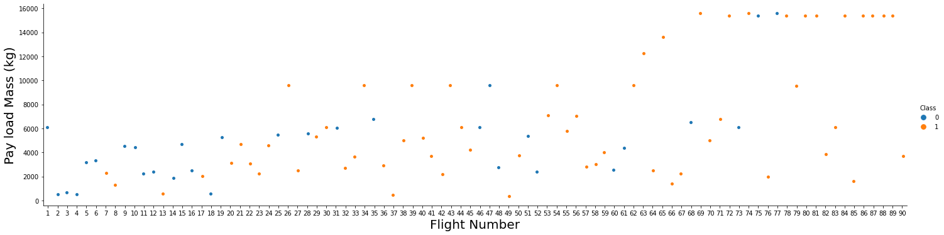
EDA with Data Visualization
In the Exploratory Data Analysis stage of this project there were several types of plots used to get insights from the data:
Seaborn Catplot (seaborn.catplot());
Matplotlib Pyplot Plot (matplotlib.pyplot.plot());
Seaborn Lineplot (seaborn.lineplot()).
Link to the file on GitHub:
https://bit.ly/3p1CCDL
As an example, here is Seaborn Catplot (scatter) plot that is used to identify the relationship between FlightNumber and PayloadMass variables:

Slide 12
EDA with SQL
SQL queries used to gain insight from the data for Exploratory Data Analysis:
Selected unique Launch Site values;
Selected 5 rows in which the values of the Launch Site column start with ‘CCA’ letters;
Calculated the total payload mass (kg) carried for the ‘NASA (CRS)’ customer;
Calculated the average payload mass (kg) carried by the ‘F9 v1.1’ booster version;
Selected the date when SpaceX successfully landed their first stage booster on a ground pad;
Selected unique mission outcome names with respective quantities.
Link to the file on GitHub:
https://bit.ly/3xoVK2s

Slide 13
Build an Interactive Map with Folium
Features used to getter a better view of the launch sites’ location on the Folium road-map:
Circle – to see the location of the object and it’s surroundings;
Marker – to indicate the name of the object on the map;
Mouse Positon Coordinates – to find the location of the mouse on the map;
Line – to calculate the distance from the main object to some point on the map
Link to the file on GitHub:
https://bit.ly/3xApedS

Slide 14
Build a Dashboard with Plotly Dash
Plotly Dash tools used for creating an interactive dashboard consisting of plots and interaction tools like:
Dropdown Box – for choosing one or all of the Launch Sites to be depicted on the Piechart;
Piechart - depicting the Launch Sites in a form of proportional sectors and corresponding number of Launches;
Range Slider – for choosing the range of the Payload Mass (kg) to be depicted on the Scatter Plot;
Scatter Plot – depicting the relationship between the Payload Mass (kg) and Classes of the rockets;
Link to the file on GitHub:
https://bit.ly/3xw4fZt

Slide 15
Predictive Analysis (Classification)
DataFrame
Defining predictor and target variables
Data Standardization
Train / Test sets split
After visual analysis were done several machine learning models were built to predict the Landing Outcome.
Link to the file on GitHub:
https://bit.ly/3I8S5ef
Logistic Regression model
Support Vector Machine model
Decision Tree Classifier model
K-Nearest Neighbor model
Grid Search
Cross Validation
Model Accuracy
SciKit Learn score metric
Confusion Matrix

Slide 16
Results
Exploratory data analysis results
Interactive analytics demo in screenshots
Predictive analysis results

Slide 17


Slide 18
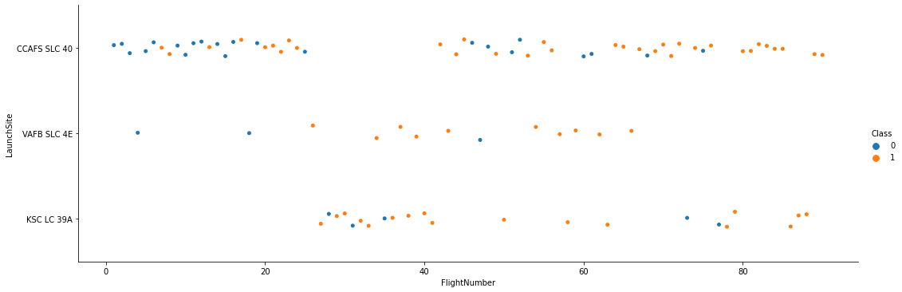
Flight Number vs. Launch Site
Observing the plot above that depicts the relationship between the ‘Flight Number’ and ‘Launch Site’ variables we can conclude that the landing outcomes of the missions that took place on ‘CCAFS SLC 40’ and ‘VAFB SLC 4E’ sites have improved as the number of flights increased. Hence the probability of future mission landing outcomes being successful also increases.

Slide 19
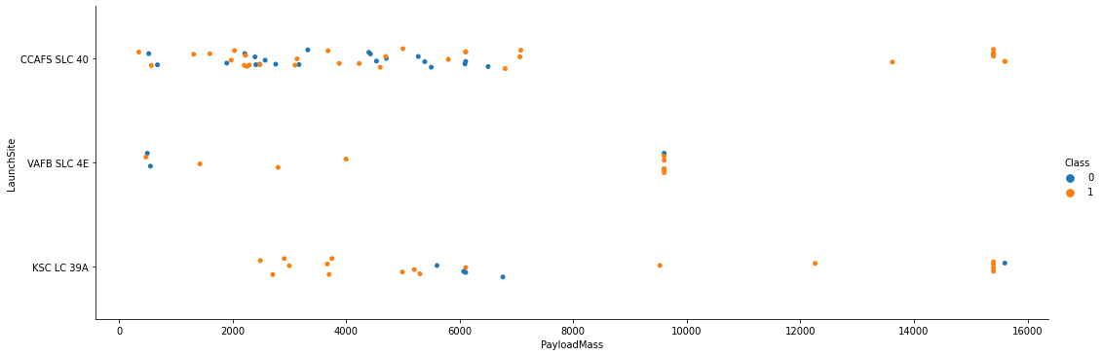
Payload vs. Launch Site
The plot above illustrates that the launches with the largest Payload Mass (14000 – 16000 kg) have taken off of ‘CCAFS SLC 40’ and ‘VAFB SLC 4E’ launch sites.
We can also see that the landing outcomes of the missions with Payload Mass above 8000 kg are mostly successful.
It is necessary to note that in missions where the Payload Mass is below 8000 kg the landing outcome is more likely to be successful for the launch site ‘KSC LC 39A’

Slide 20
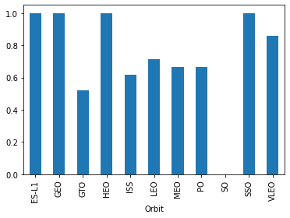
Success Rate vs. Orbit Type
On the bar chart to the right we can see that the orbit types with the highest Success Rate (100%) of landing outcomes are ‘ES-L1’, ‘GEO’, ‘HEO’ and ‘SSO’.
The lowest Success Rate of landing outcomes on this chart is for SO (Sub-Orbital) orbit type. This is because the goal of this mission was to test the first Crew Dragon (C205) with in-flight abort system. The first stage was destroyed after Crew Dragon detached, which was expected. This same first stage booster has completed 4 successful landings before this mission.

Slide 21
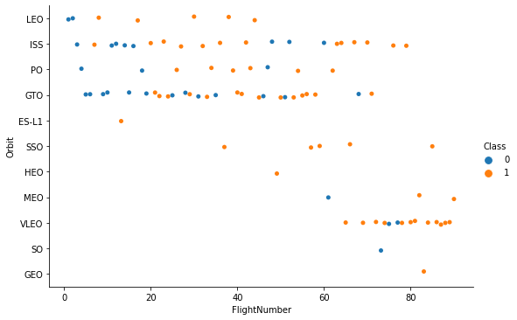
Flight Number vs. Orbit Type
On this scatter plot we can see that the Success Rates of landing outcomes for ‘LEO’, ‘SSO’ and ‘VLEO’ orbit types are relatively higher and more consistent.
It is worth noting that as the number of flights of the company increased the VLEO (Very Low Earth Orbit) orbit type has been used more frequently for the missions. This is because SpaceX has started deploying their own Starlink internet satellites to this orbit.

Slide 22
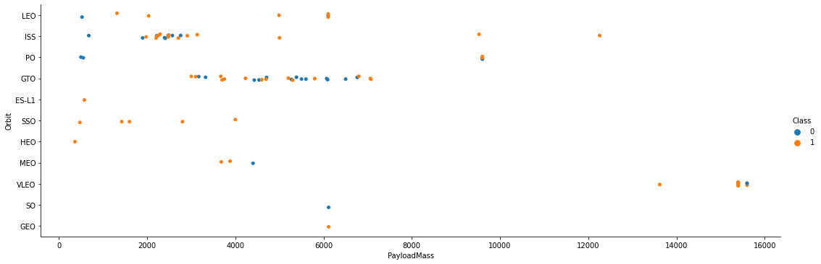
Payload vs. Orbit Type
On this scatter plot we can see that the Success Rate for the ‘LEO’ and ‘SSO’ orbit types is relatively higher with launch Payload Mass below 8000 kg, although most of the launches are aimed toward ‘ISS’ and ‘GTO’ obit types

Slide 23
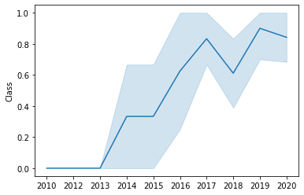
Launch Success Yearly Trend
On this line graph we can see that from 2013 to 2020 SpaceX has significantly improved in terms of Success Rate of landing outcomes. It took only 7 years for SpaceX to go from 0% to ≈85% Success Rate of landing outcomes, which is extremely impressive.

Slide 24
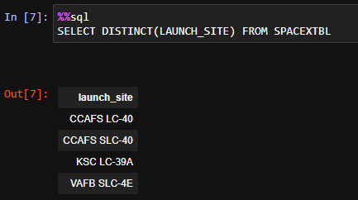
All Launch Site Names
Selecting the rows using ‘DISTINCT()’ clause to return all unique values from the ‘LAUNCH_SITE’ column of the ‘SPACEXTBL’ table

Slide 25
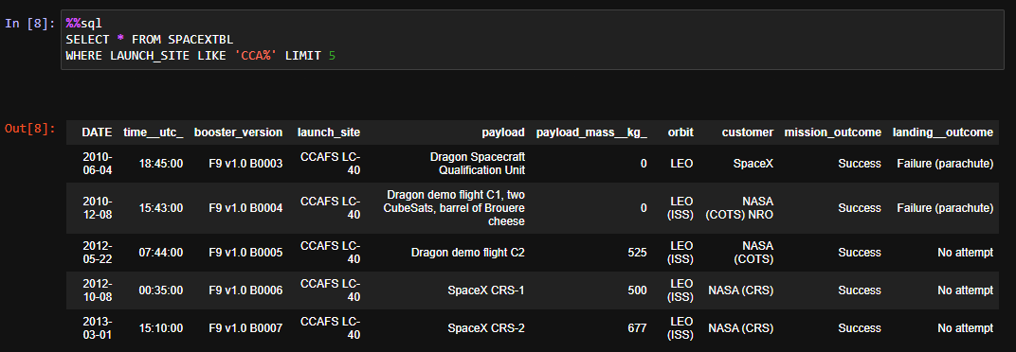
Launch Site Names Begin with 'CCA'
Using ‘*’ sign gets all the rows from the ‘SPACEXTBL’;
We use ‘WHERE’ clause and ‘LIKE’ operator to filter out the result to get only rows that have ‘LAUNCH_SITE’ values starting with “CCA” letters;
We use ‘LIMIT’ clause to limit the number of returned rows to 5

Slide 26
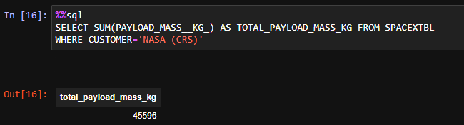
Total Payload Mass
Using ‘SUM()’ aggregate function to calculate the total of the values in the ‘PAYLOAD_MASS__KG_’ column of the ‘SPACEXTBL’ table
Using ‘AS’ command to create a ‘TOTAL_PAYLOAD_MASS_KG’ alias for the new column
Using ‘WHERE’ clause with ‘=‘ operator to filter out the result for the calculation of the values where ‘CUSTOMER’ column values are “NASA (CRS)”

Slide 27
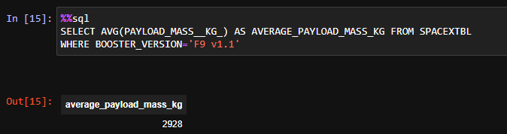
Average Payload Mass by F9 v1.1
Using ‘AVG()’ function to calculate the average of the values in the ‘PAYLOAD_MASS__KG_’ column of the ‘SPACEXTBL’ table
Using ‘AS’ command to create a ‘AVERAGE_PAYLOAD_MASS_KG’ alias for the new column
Using ‘WHERE’ clause with ‘=‘ operator to filter out the result for the calculation of the values where ‘BOOSTER_VERSION’ column values are “F9 v1.1”

Slide 28
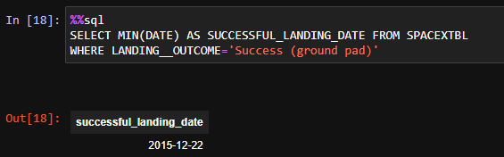
First Successful Ground Landing Date
Using ‘MIN()’ function to the oldest date from the ‘DATE’ column of the ‘SPACEXTBL’ table
Using ‘AS’ command to create a ‘SUCCESSFUL_LANDING_DATE’ alias for the new column
Using ‘WHERE’ clause with ‘=‘ operator to filter out the result for the values where ‘LANDING_OUTCOME’ column values are “Success (ground pad)”

Slide 29
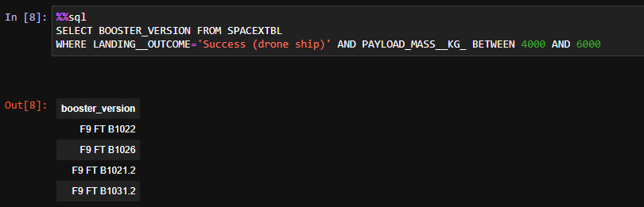
Successful Drone Ship Landing with Payload between 4000 and 6000
Selecting values from the ‘BOOSTER_VERSION’ column of the ‘SPACEXTBL’ table
Using ‘WHERE’ clause with ‘=‘, ‘AND’ and ‘BETWEEN’ operators to filter out the result for the values where ‘LANDING_OUTCOME’ column values are “Success (drone ship)” and ‘PAYLOAD_MASS__KG_’ values are between ‘4000’ and ‘6000’

Slide 30
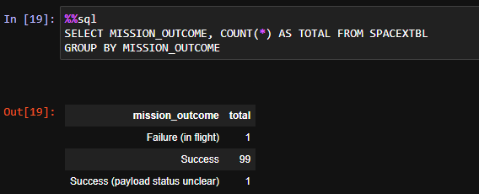
Total Number of Successful and Failure Mission Outcomes
Selecting ‘MISSION_OUTCOME’ values using ‘COUNT()’ and ‘*’ sign to calculate the number of missions in the ‘SPACEXTBL’ table
Using ‘AS’ command to create a ‘TOTAL’ alias for the new column
Using ‘GROUP BY’ clause to group the results by ‘MISSION_OUTCOME’ values

Slide 31
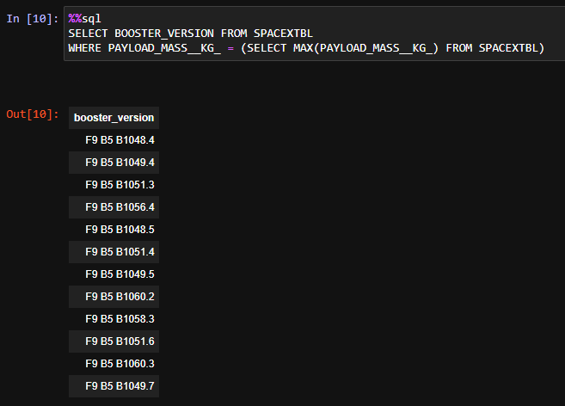
Boosters Carried Maximum Payload
Selecting values from the ‘BOOSTER_VERSION’ column of the ‘SPACEXTBL’ table
Using ‘WHERE’ clause with ‘=‘ operator to filter out the result for the values where ‘PAYLOAD_MASS__KG_’ column values are same as the largest value in this column selected using ‘MAX()’ function

Slide 32
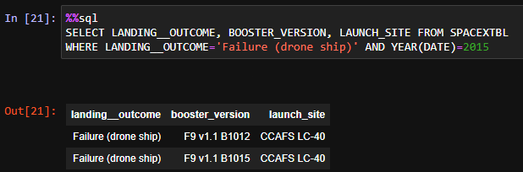
2015 Launch Records
Selecting values from the ‘LANDING_OUTCOME’, ‘BOOSTER_VERSION’ and ‘LAUNCH_SITE’ columns of the ‘SPACEXTBL’ table
Using ‘WHERE’ clause with ‘=‘, ‘AND’ operator and YEAR() function to filter out the results where ‘LANDING_OUTCOME’ column values are “Failure (drone ship)” and the year values of the ‘DATE’ column are 2015

Slide 33
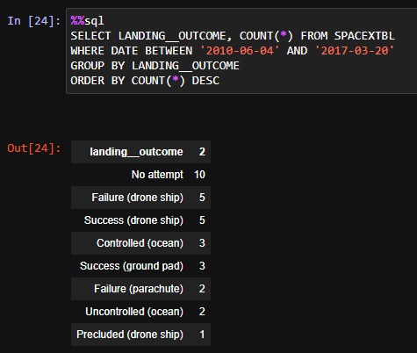
Rank Landing Outcomes Between 2010-06-04 and 2017-03-20
Selecting values from the ‘LANDING__OUTCOME’ and using ‘COUNT()’ function with ‘*’ sign to calculate the number of rows in the ‘SPACEXTBL’ table
Using ‘WHERE’ clause with ‘=‘, ‘AND’ and ‘BETWEEN’ operators to filter out the result for the values where ‘DATE’ column values are between ‘2010-06-04’ and ‘2017-03-20’
Using ‘GROUP BY’ clause to group the values of the ‘LANDING_OUTCOME’ column
Using ‘ORDER BY’ clause to sort the values by the number of rows in each group

Slide 34


Slide 35
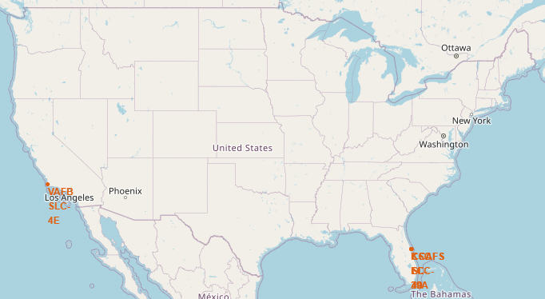
Partial road-map of the USA with Launch Site locations
As you can see on this map, the ‘VAFB SLC-4E’ launch site is located in California. As the launch sites ‘KSC LC-39A’, ‘CCAFS SLC-40’ and ‘CCAFS LC-40’ are located close to each in Florida the location looks like one spot on this map.

Slide 36
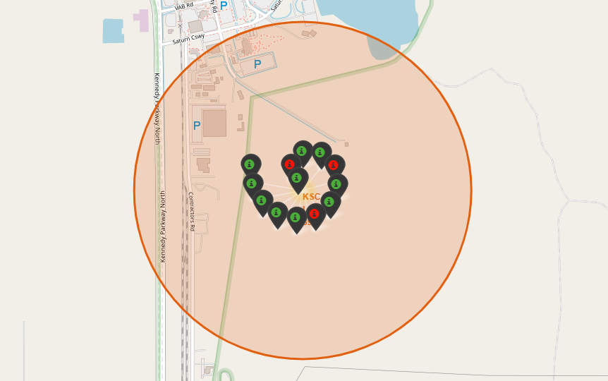
Road-map with landing outcomes
This road-map depicts an area with ‘KSC LC-39A’ launch site located in the center and landing outcomes with green/red colored markers surrounding it

Slide 37
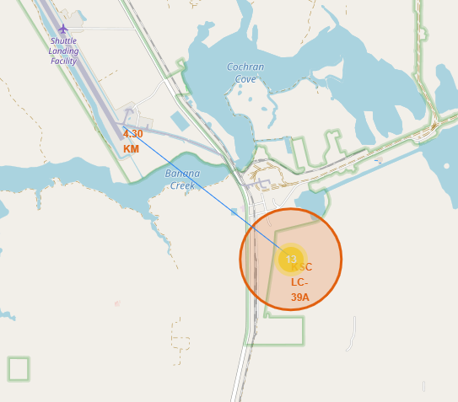
Road-map with calculated distance
This road-map depicts the calculated distance (4.3 km) between ‘KSC LC-39A’ and ‘Shuttle Landing Facility’.

Slide 38


Slide 39
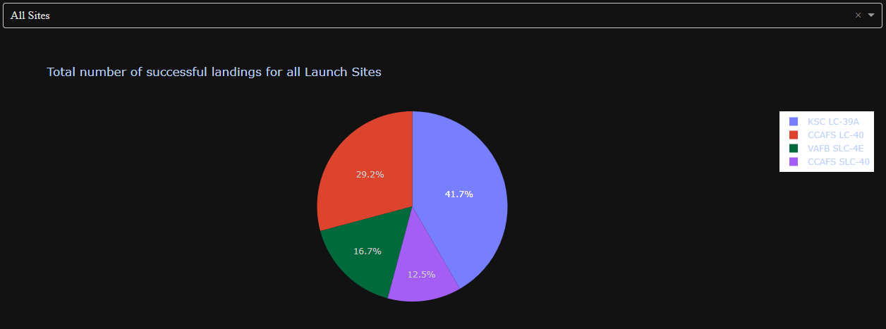
Pie-chart with total number of successful landing outcomes
This Pie-chart makes it obvious that the ‘KSC LC-39A’ launch site has the largest share of successful landing outcomes among other launch sites

Slide 40
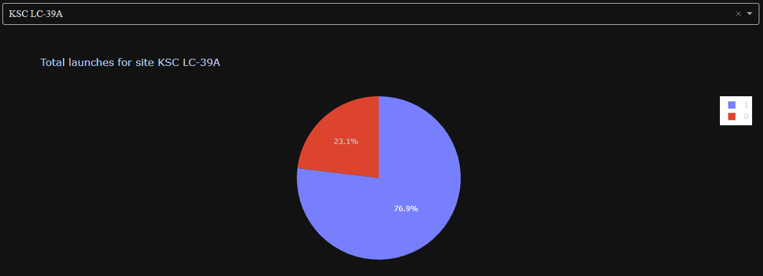
Pie-chart with the success rate of landing outcome for one launch site
This Pie-chart depicts that the success rate of landing outcomes for the ‘KSC LC-39A’ launch site is 76.9%.

Slide 41
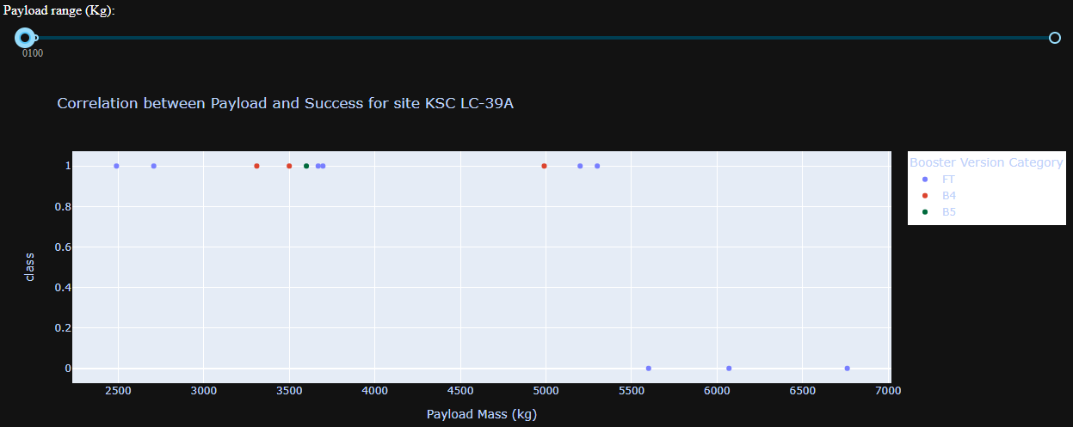
Scatter-plot with Success Rate depicted using Booster Version Category and Payload Mass (kg) relationship
On this scatter plot we can see that the rocket with ‘FT’ Booster Version Category has performed all launches with Payload Mass above 5500 kg and they were all unsuccessful in terms of landing outcomes.
At the same time most of the successful landing outcomes with Payload Mass below 5500 kg belong to the same booster version.

Slide 42


Slide 43
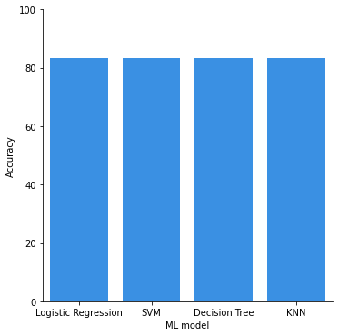
Classification Accuracy
On this bar chart we can see that all the models built return the same accuracy level of 83.33%.

Slide 44
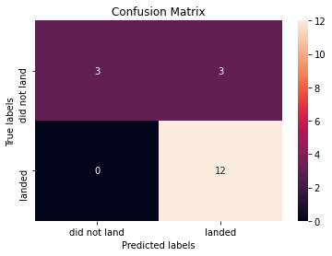
Confusion Matrix
As all of our models returned the same level of accuracy, we can observe the overall result on one heat-plot. On this confusion matrix heat-plot there was a total of 18 landing outcomes and 6 of them were unsuccessful. Our models could only predict half of 6 unsuccessful outcomes correctly (True Positive).
On the other hand our models could predict correctly all 12 successful outcomes (True Negative).

Slide 45
Conclusions
The Success Rate of SpaceX mission’s landing outcomes have gone from 0% (2013) to ≈85% (2020). This is roughly 12% increase every year, which is extremely impressive;
The orbit types with the highest Success Rate (100%) of the landing outcomes are: ‘ES-L1’, ‘GEO’, ‘HEO’ and ‘SSO’. Although it should be considered that there was only 1 mission launched to the first 3 orbit types;
The orbit type with the lowest Success Rate (≈52%) is ‘GTO’. We don’t consider ‘SO’ orbit type here because the loss of the first stage in this mission was required for Crew Dragon (C205) abort system testing purposes;
Most of the missions (≈74%) had payload mass below 8000 kg and the Success Rate of this missions is ≈60%. The Success Rate of the missions with payload mass above 8000 kg is ≈87%;
The orbit type with highest Success Rate with payload mass below 8000 kg are the ones indicated in the second bullet;
The ‘KSC LC-39A’ launch sites has a ≈41% portion of all successful landing outcomes among other launch sites. The ‘CAFS SLC-40’ launch sites has a ≈12% portion, which is the lowest;
All unsuccessful landing outcomes have happened with the first stages within ‘FT’ booster version category and all of these launches had a payload mass above 5500 (kg). The first stages within ‘B4’ and ‘B5’ booster version category had 100% Success Rate.

Slide 46
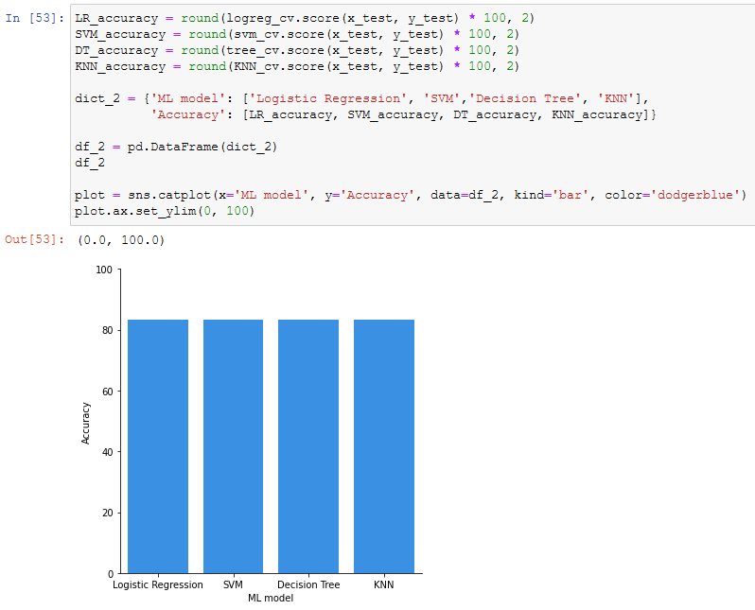
Appendix

Slide 47


